Slide 1

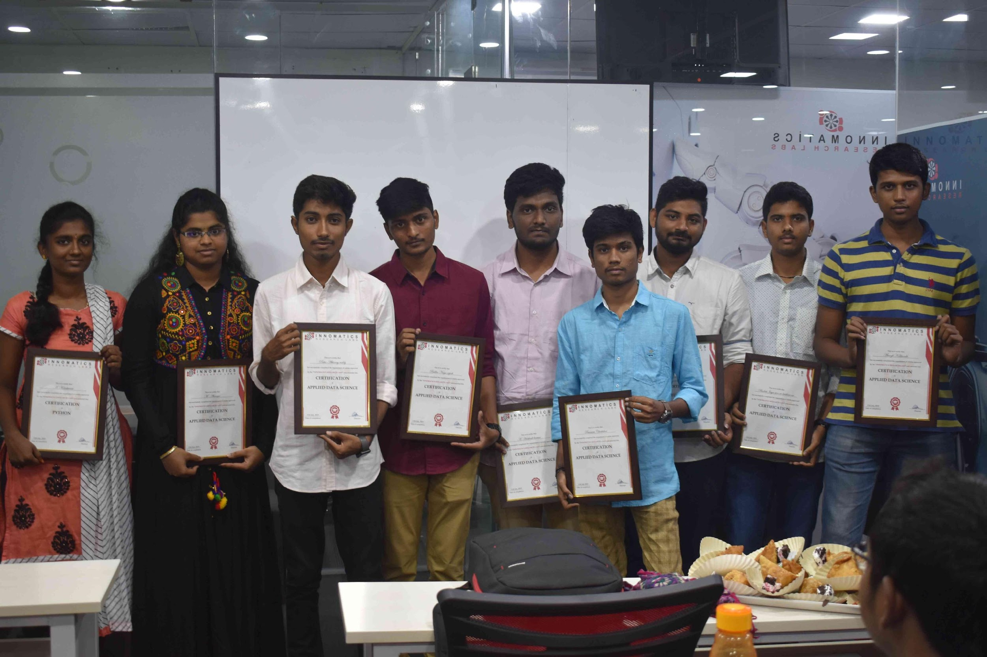
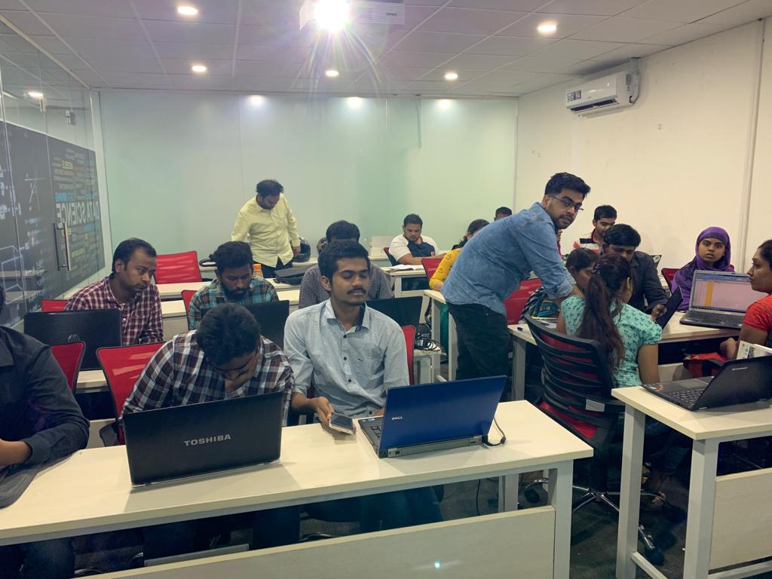

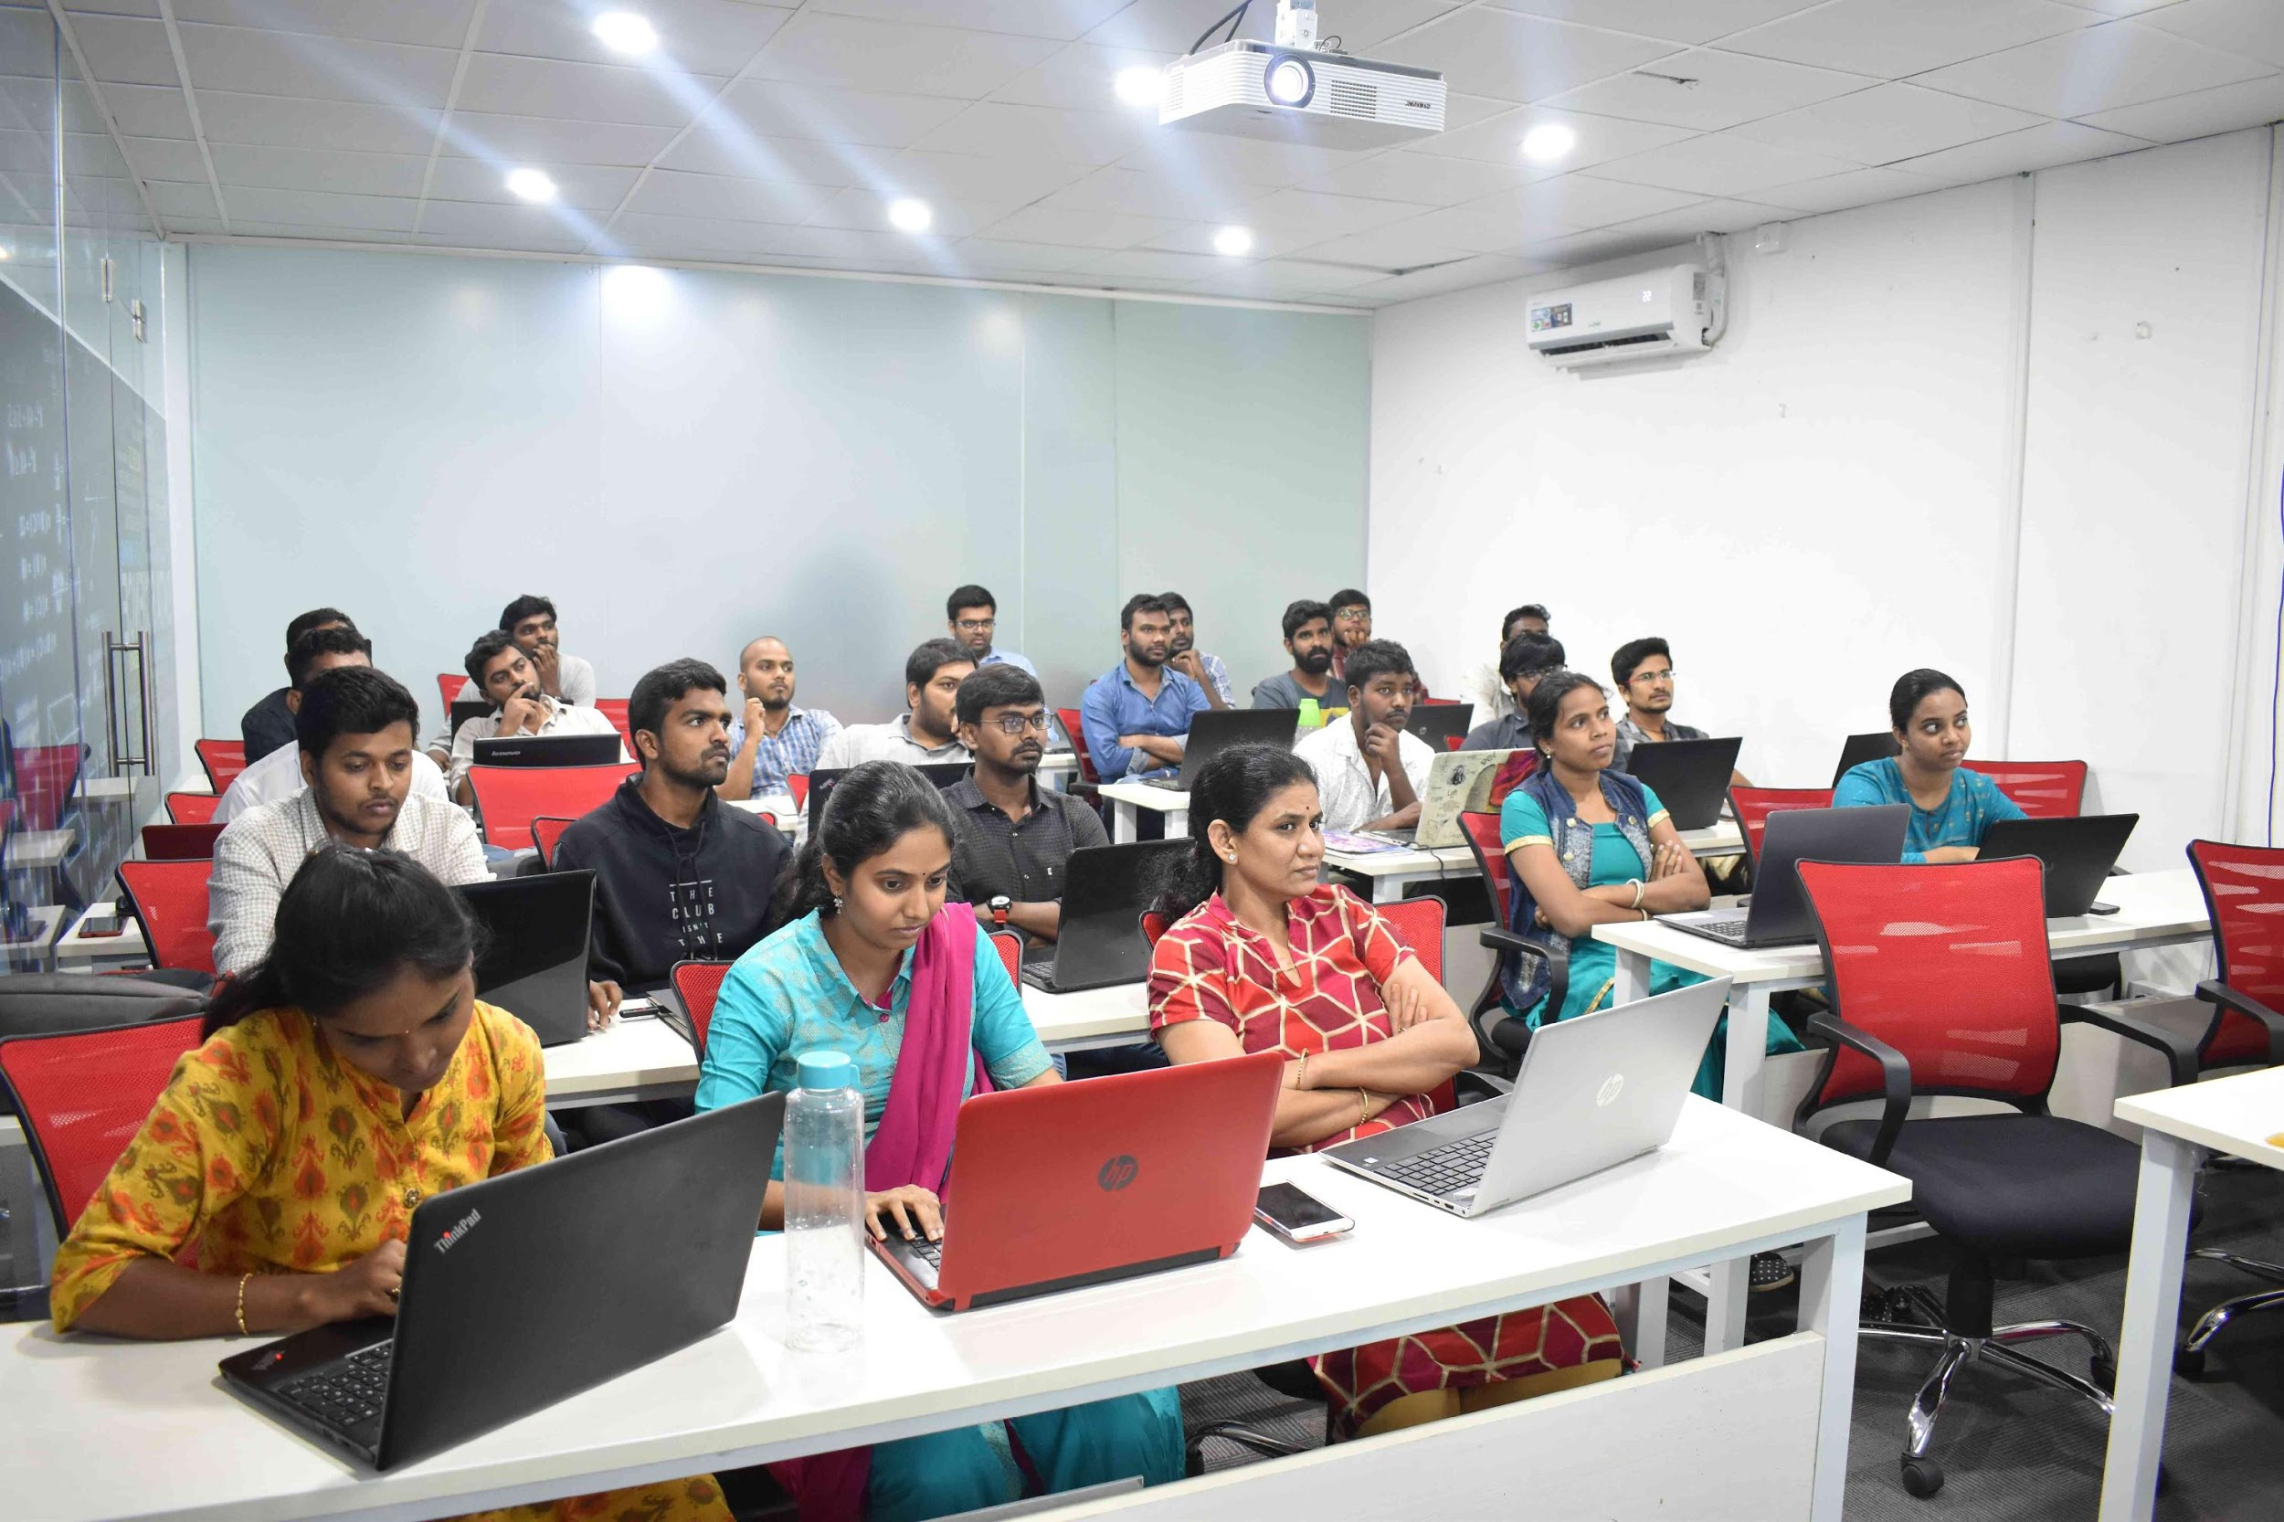
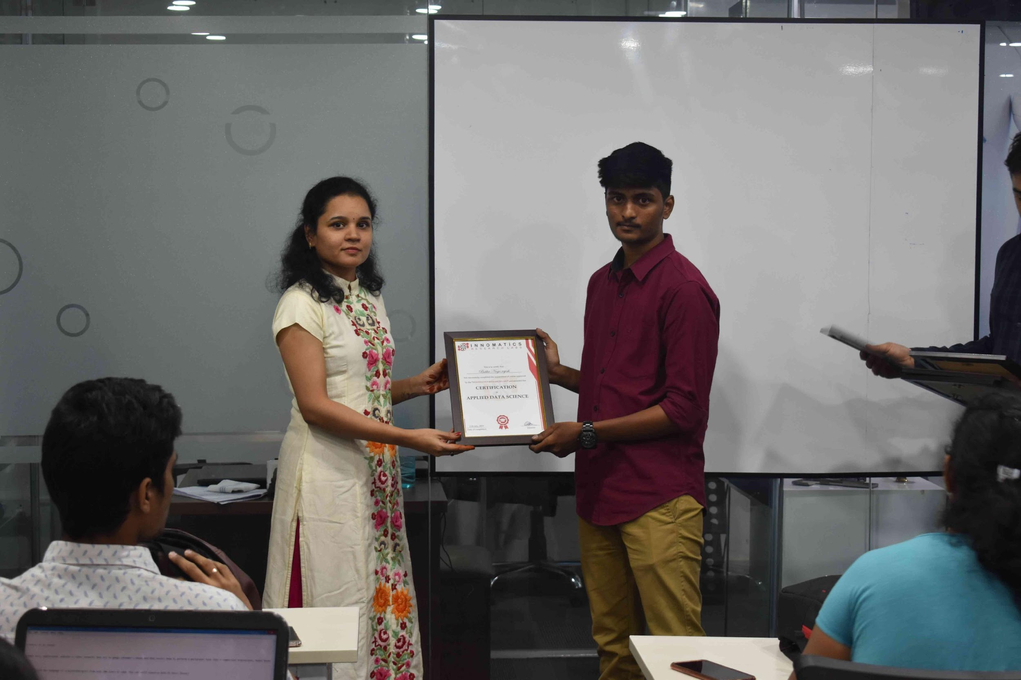


Slide 2
Music Recommender System
Presentation by Team 6

Slide 3
EDA and Data Preparation
Understanding the Data :-
To Build Music Recommendation System, we used the Million Songs Dataset. This Dataset contains five files -
kaggle_users - contains the list of user_ids
kaggle_songs - contains list of song_ids
kaggle_visible_evaluation_triplets - contains user_id,song_id and freq
unique_tracks - contains track_id,song_id,artist_name and release
taste_profile_songs_to_tracks

Slide 4
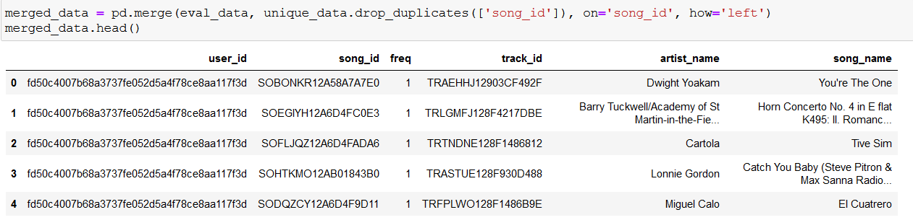
Combining the two files i.e., triplets and unique_tracks(over here eval_data and unique_data).
Total record found was 1,450,933. Including unique users(110,000), unique songs(163,206) and unique artists(28,361).
Analysis of Song Popularity, we found “Sehr kosmisch” was most famous song in the data which was streamed by more than 5000 users.
Analysis of Popularity of an Artist, we found “Coldplay” was the most famous artist in the data. Streamed by more than 7000 users.
How much days the most obsessed user can be the fan of a unique song: 2.2.

Slide 5
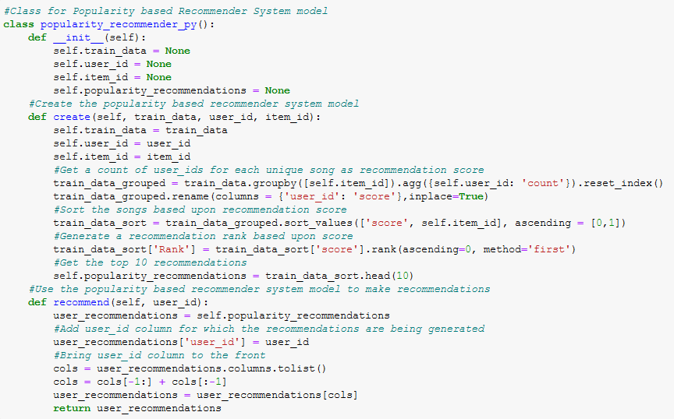
Popularity Based Model
Class -
popularity_recommender_py
Functions -
create
recommend

Slide 6
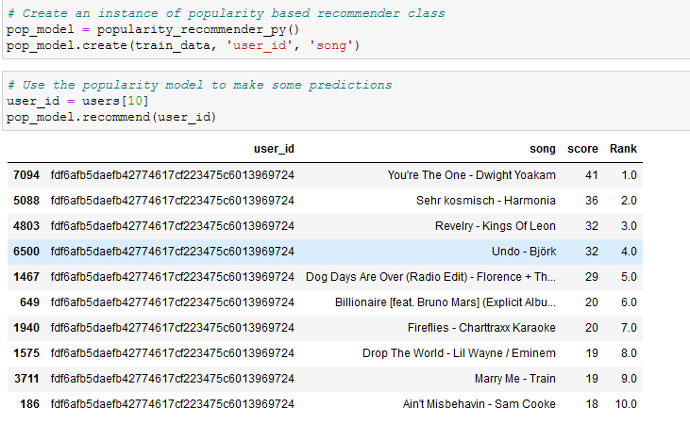
Loading the class into a variable pop_model to create popularity based model.
Later creating a model using train_data
Predictions made

Slide 7
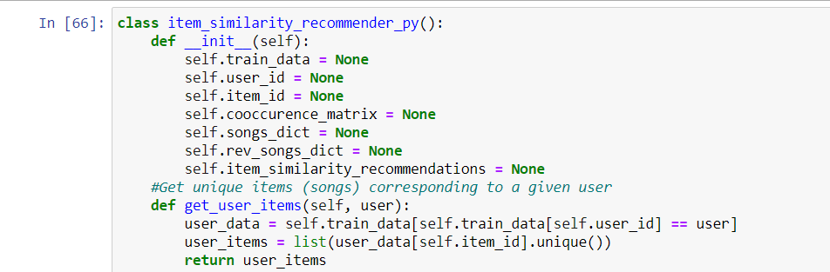
Collaborative Based Model
Class - item_similarity_recommender_py
Functions -
init
get_user_items

Slide 8
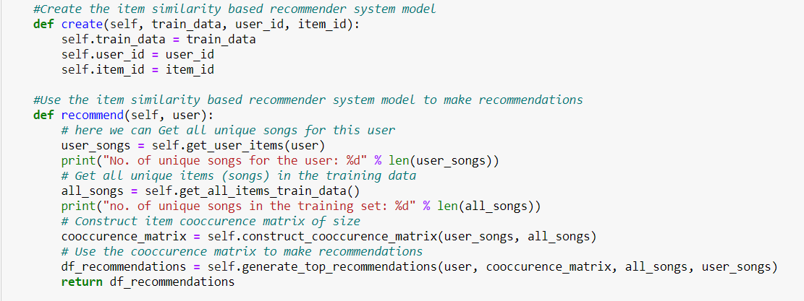
Function -
create
recommend

Slide 9
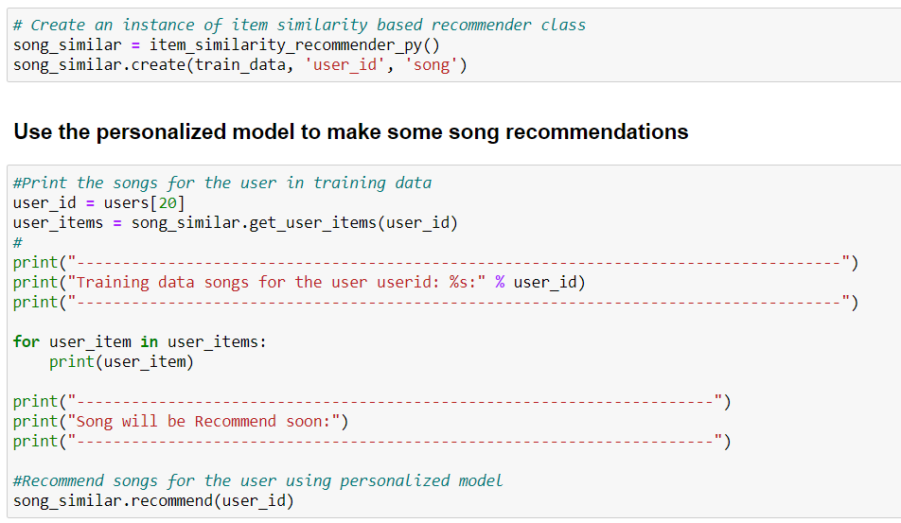
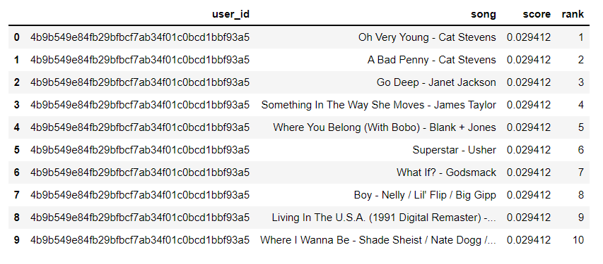
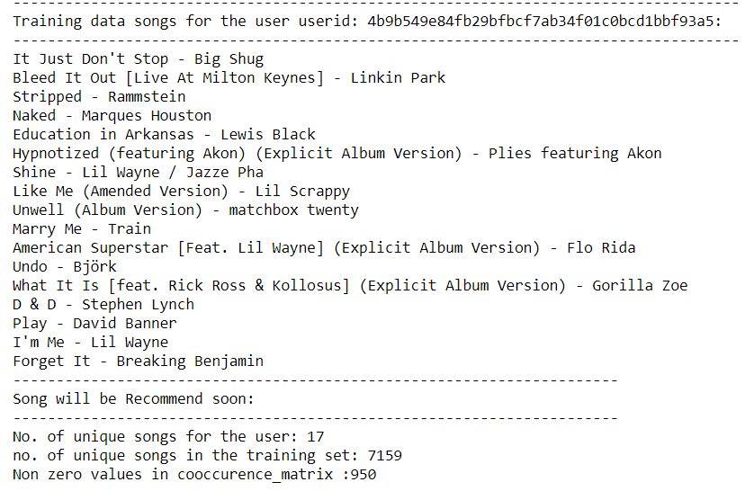

Slide 10
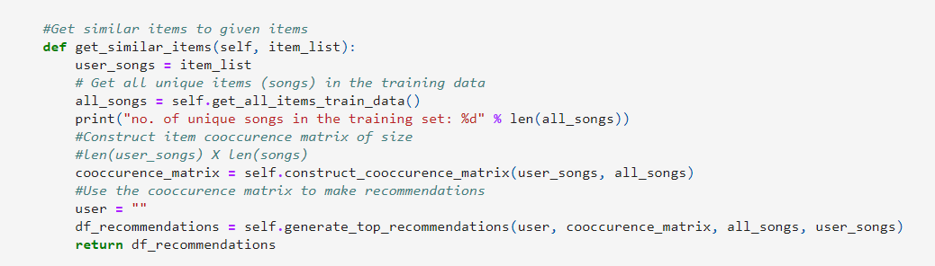
Content Based Model
Function :-
get_similar_items

Slide 11
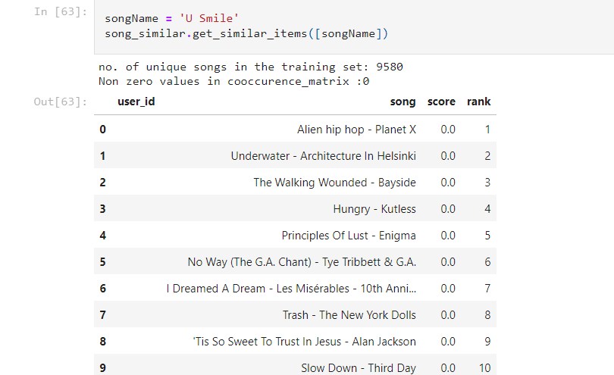

Slide 12
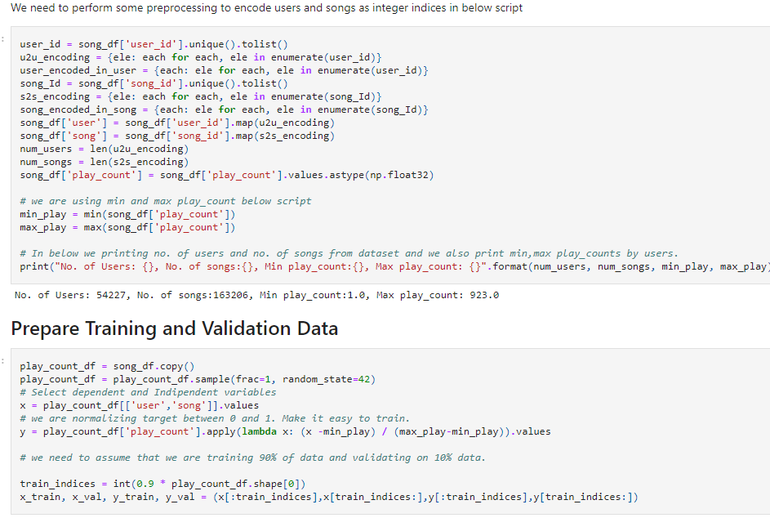
Keras Models - Collaborative and Popularity
Steps
map user_id to user vec.
map song_id to song vec.
compute dot products by using above two.
Train embeddings via gradient descent using all known user-song pairs.

Slide 13
Model Creation
Collaborative and top n no. of songs recommendations.
2. Matrix Factorization based song recommendation to user.

Slide 14
Future Scope & Conclusion
We explain a basic metadata-based model and two popular music recommender approaches: collaborative ﬁltering and content-based model.
Though they have achieved great success, their drawbacks such as popularity bias and human eﬀorts are obvious.
Moreover, the use of hybrid model would outperform a single model since it incorporates the advantages of both methods. Its complexity is not fully studied yet.
Due to the subjective nature in music and the issues existing in the previous methods, two approaches are proposed.
By considering aﬀective and social information, collaborative-based model and content-based model largely improved the quality of recommendation.
One of the best recommendation engine by Spotify, it uses Collaborative Filtering, NLP and Audio modeling(overcomes cold-start-problem).

Slide 15
About Team Members
VRUSHABH CHAUHAN
MSc. BDA & Data Science
Working with different types of data interests me.
No Work Experience.
The teaching is awesome.
2. MANISHA BOORLA
M.Sc.(Applied Statistics)
To improve problem solving skills.
No Experience.
The Teaching Part .
3. BOREDDY SAI KIRAN REDDY
B.Tech(ECE)
Exploring new thoughts of solving.
No Experience.
The way of teaching is excellent.
4. SHUBHAM SHELKE
MSc. Data Science & BIg Data Analytics
Working on different data and finding new insight.
No work Experience.
Way of teaching ,mentors guidance is excellent.
5. SUMIT K. SUDALKAR
Mechanical engineer
love to work with data and also like to work in fullstack data science.
No work Experience.
Way of teaching ,mentors guidance is excellent and my concepts are cleared like crystal.

Slide 16

THANK YOU

